Slide 1
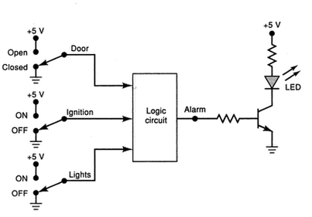
Exp-3
Fig. shows the diagram for an automobile alarm circuit used to detect certain undesirable conditions. The three switches are used to indicate the status of the door by the driver’s seat (DS), the ignition (IS), and the headlights (HS), respectively. Design a logic circuit with these switches as inputs so that the alarm (A) will be activated only whenever either of the following conditions exists:
● The headlights are ON while the ignition is OFF
● The door is open while the ignition is ON.
Implement the above circuit using:
(1) Minimum no. of 2-inputs NAND gates
(2) A 3:8 decoder and suitable 2-input logic gates.
Assume the decoder outputs to be active low.
RJEs: Remote job entry points

